Slide 1
An Examination of Chinese Ideals
By Fred and Rosie

Slide 2
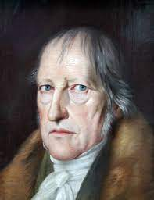
Intro To Hegel
August 27th 1770- November 14th 1831
Influenced by Immanuel Kant, Rene Descartes, Friedrich Von Schelling, Jean-Jacques Rousseau
https://www.youtube.com/watch?v=_xbZzxet9Cs&t=1501s
0:00-4:36

Slide 3
Hegel’s Geist
Humans are made up of their spirits, souls, and minds
Geist is ever changing and evolving with history and humanity
Every historical Epoch has its own geist
Freedom and rationality are closely related to Hegle
Humans represent history, and history represents humanity.
Each person’s life represent the evolution of history
Start of live is the start of history
The overall goal of history is to reach the end of human existence
People can only comprehend history after the time period has past, not during the time period

Slide 4
Black Li, White Li by Lao She
Represent old values, and new values.
Old values (Black Li)- Confucianism, education, family centered, respect of elders, Filial Piety, some folklore religions, and more
New values (White Li)- Individualism, rejection of traditional values, rejection of religion, societal shift from focusing on the whole population, to the individual.
“I recall what happened very clearly. On a drizzly night in early summer, I went to have a chat with him [Black Li] in his home. He was sitting alone in his room with four fine porcelain tea bowls decorated with red fish standing on the table before him. We were very informal whenever we got together. I sat down and lit a cigarette while he played with his tea bowls. He turned them around, one by one, until the fish designs painted on them were all facing him.”
In what line of the excerpt do we see traditional values, and how are they challenged?
How does this relate to Hegel’s views of comiratury?

Slide 5
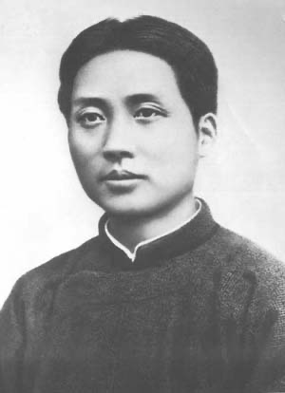
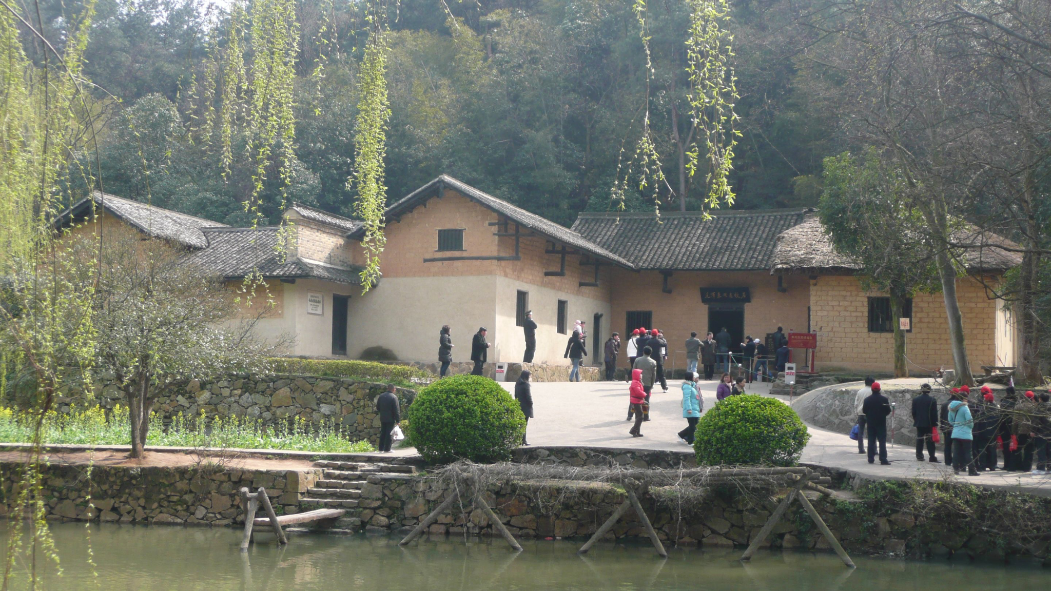
Intro To Mao
Early Ages

Slide 6
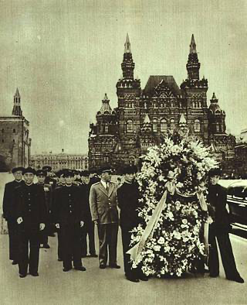
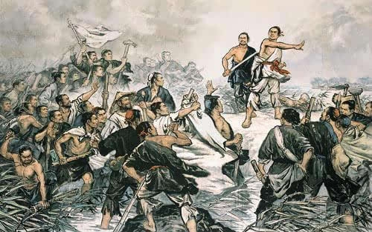
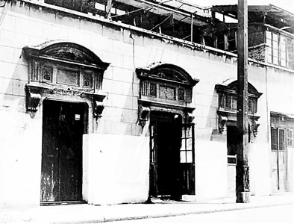
Mao’s Theory on Peasant Revolution

Slide 7
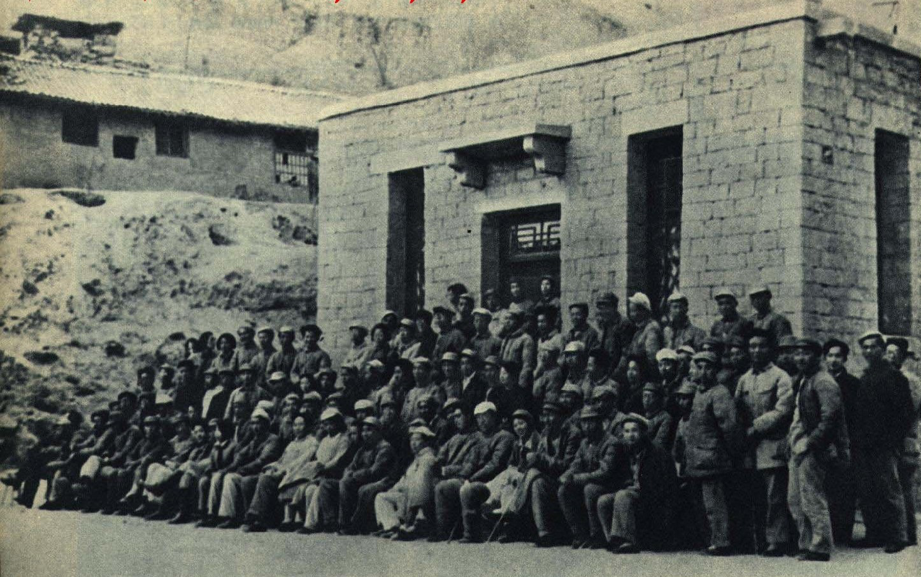
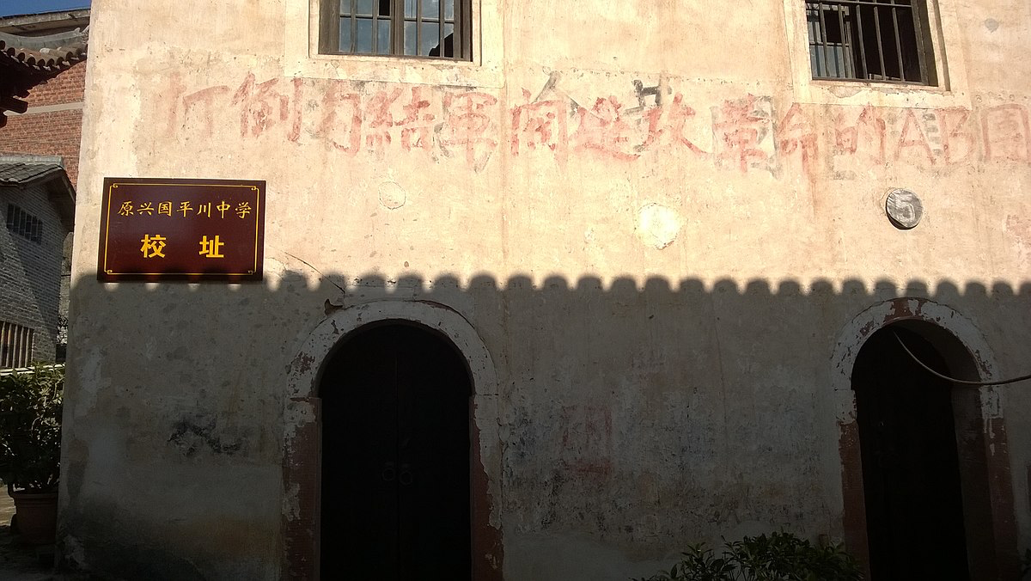
Anti-Bolsheviks Conspiracy
Yan’an Rectification

Slide 8
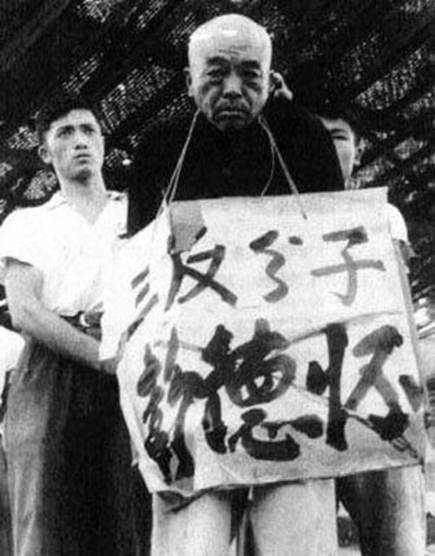
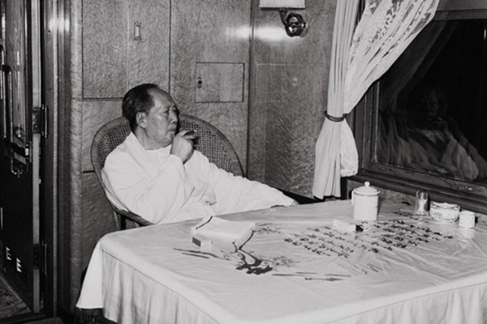
After 1949

Slide 9
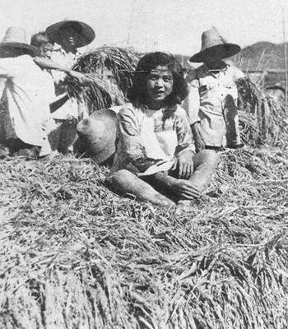
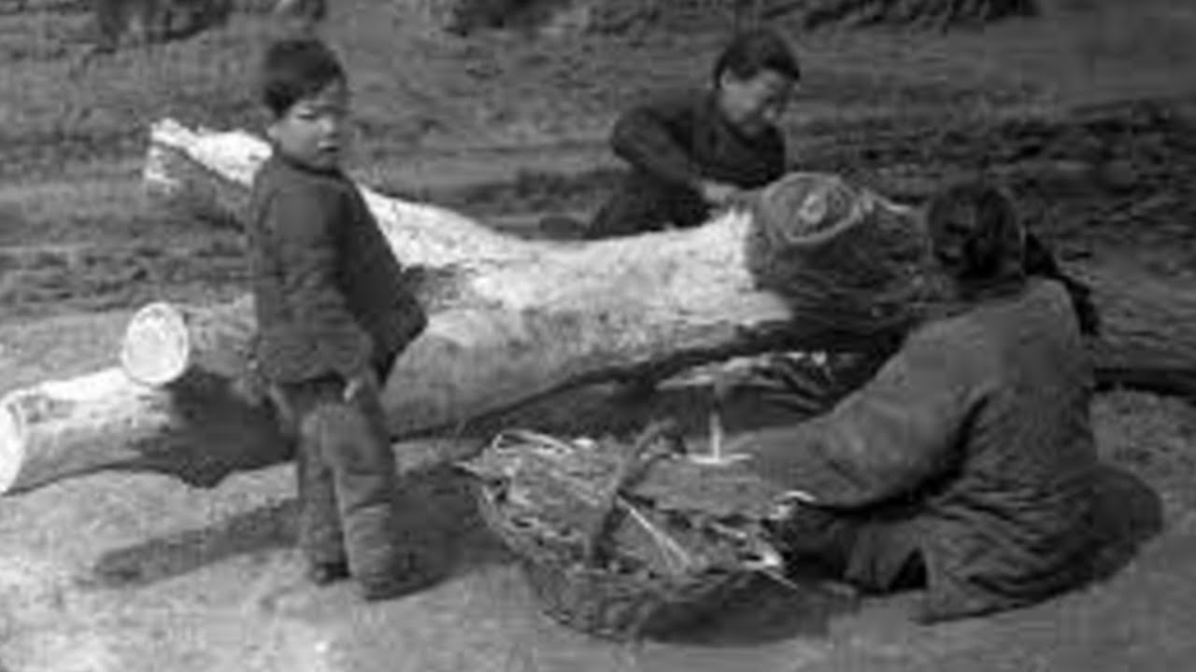
Great Leap Forward and The Famine

Slide 10
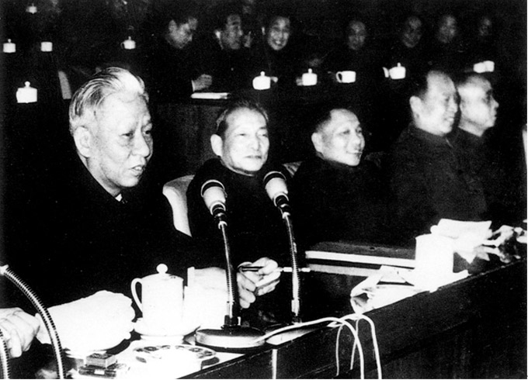
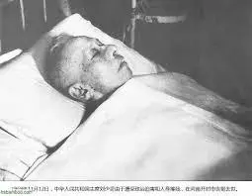
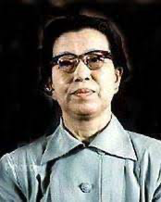
Seven-Thousand Conference and CC

Slide 11
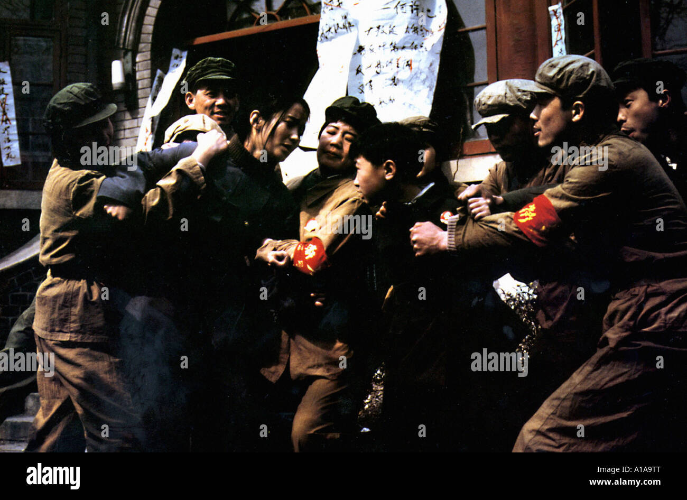
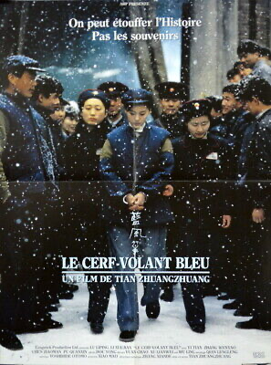
The Blue Kite

Slide 12
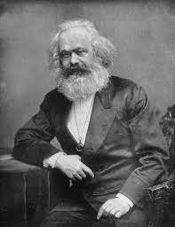
Intro to Marx
“The bourgeoisie, by the rapid improvement of all instruments of production, by the immensely facilitated means of communication, draws all, even the most barbarian, nations into civilisation. The cheap prices of commodities are the heavy artillery with which it batters down all Chinese walls, with which it forces the barbarians’ intensely obstinate hatred of foreigners to capitulate. It compels all nations, on pain of extinction, to adopt the bourgeois mode of production; it compels them to introduce what it calls civilisation into their midst, i.e., to become bourgeois themselves. In one word, it creates a world after its own image.”
Connection: how Mao reflects on Marx’s theories.
May 5th, 1818- March 14th 1883
Influenced by Immanuel Kant, Friedrich Engels, Adam Smith, and Georg Hegel

Slide 13
Alain Badiou and Victor Hugo
Babarisium
“If we were forced to choose between the barbarians of civilization and the civilized men of barbarism, we should choose the barbarians”(Badiou).
Webster’s dictionary defines a barbarian as “a person from an alien land, culture, or group believed to be inferior, uncivilized, or violent.”
It is a clear examination of history being opened up to the people. (as discussed earlier with Black Li, White Li)
Similar to the novel Les Miserable, Farewell my Concubine examines relationships between individuals on a micro scale, from within the revolts on a macro scale.

Slide 14
Discussion Questions
How does Hegel's Philosophy fit into Chinese Literary work that we have discussed in class?
How does Hegel's Philosophy relate to other philosophers were have discuss in class?
How do Marx and Mao Compare to each other?

