Slide 1
The cause of May Fourth Movement(1919)
and the contributions it made
Jerry Yang

Slide 2
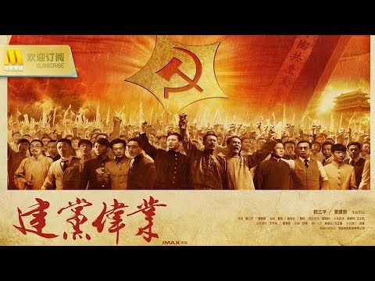

Slide 3
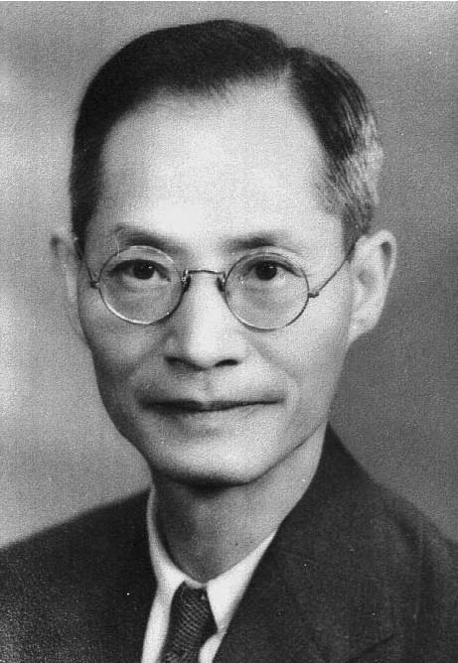
Jiang Menglin (蒋梦麟）
Professor at Peking University
Became the Headmaster of Peking University and Secretary of Education in 1928

Slide 4
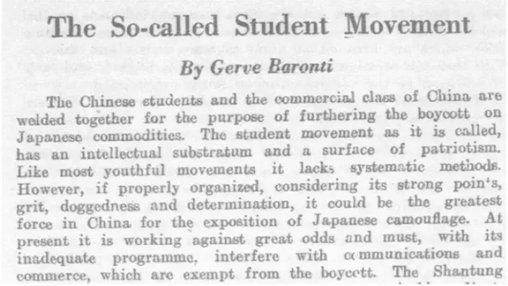

Slide 5
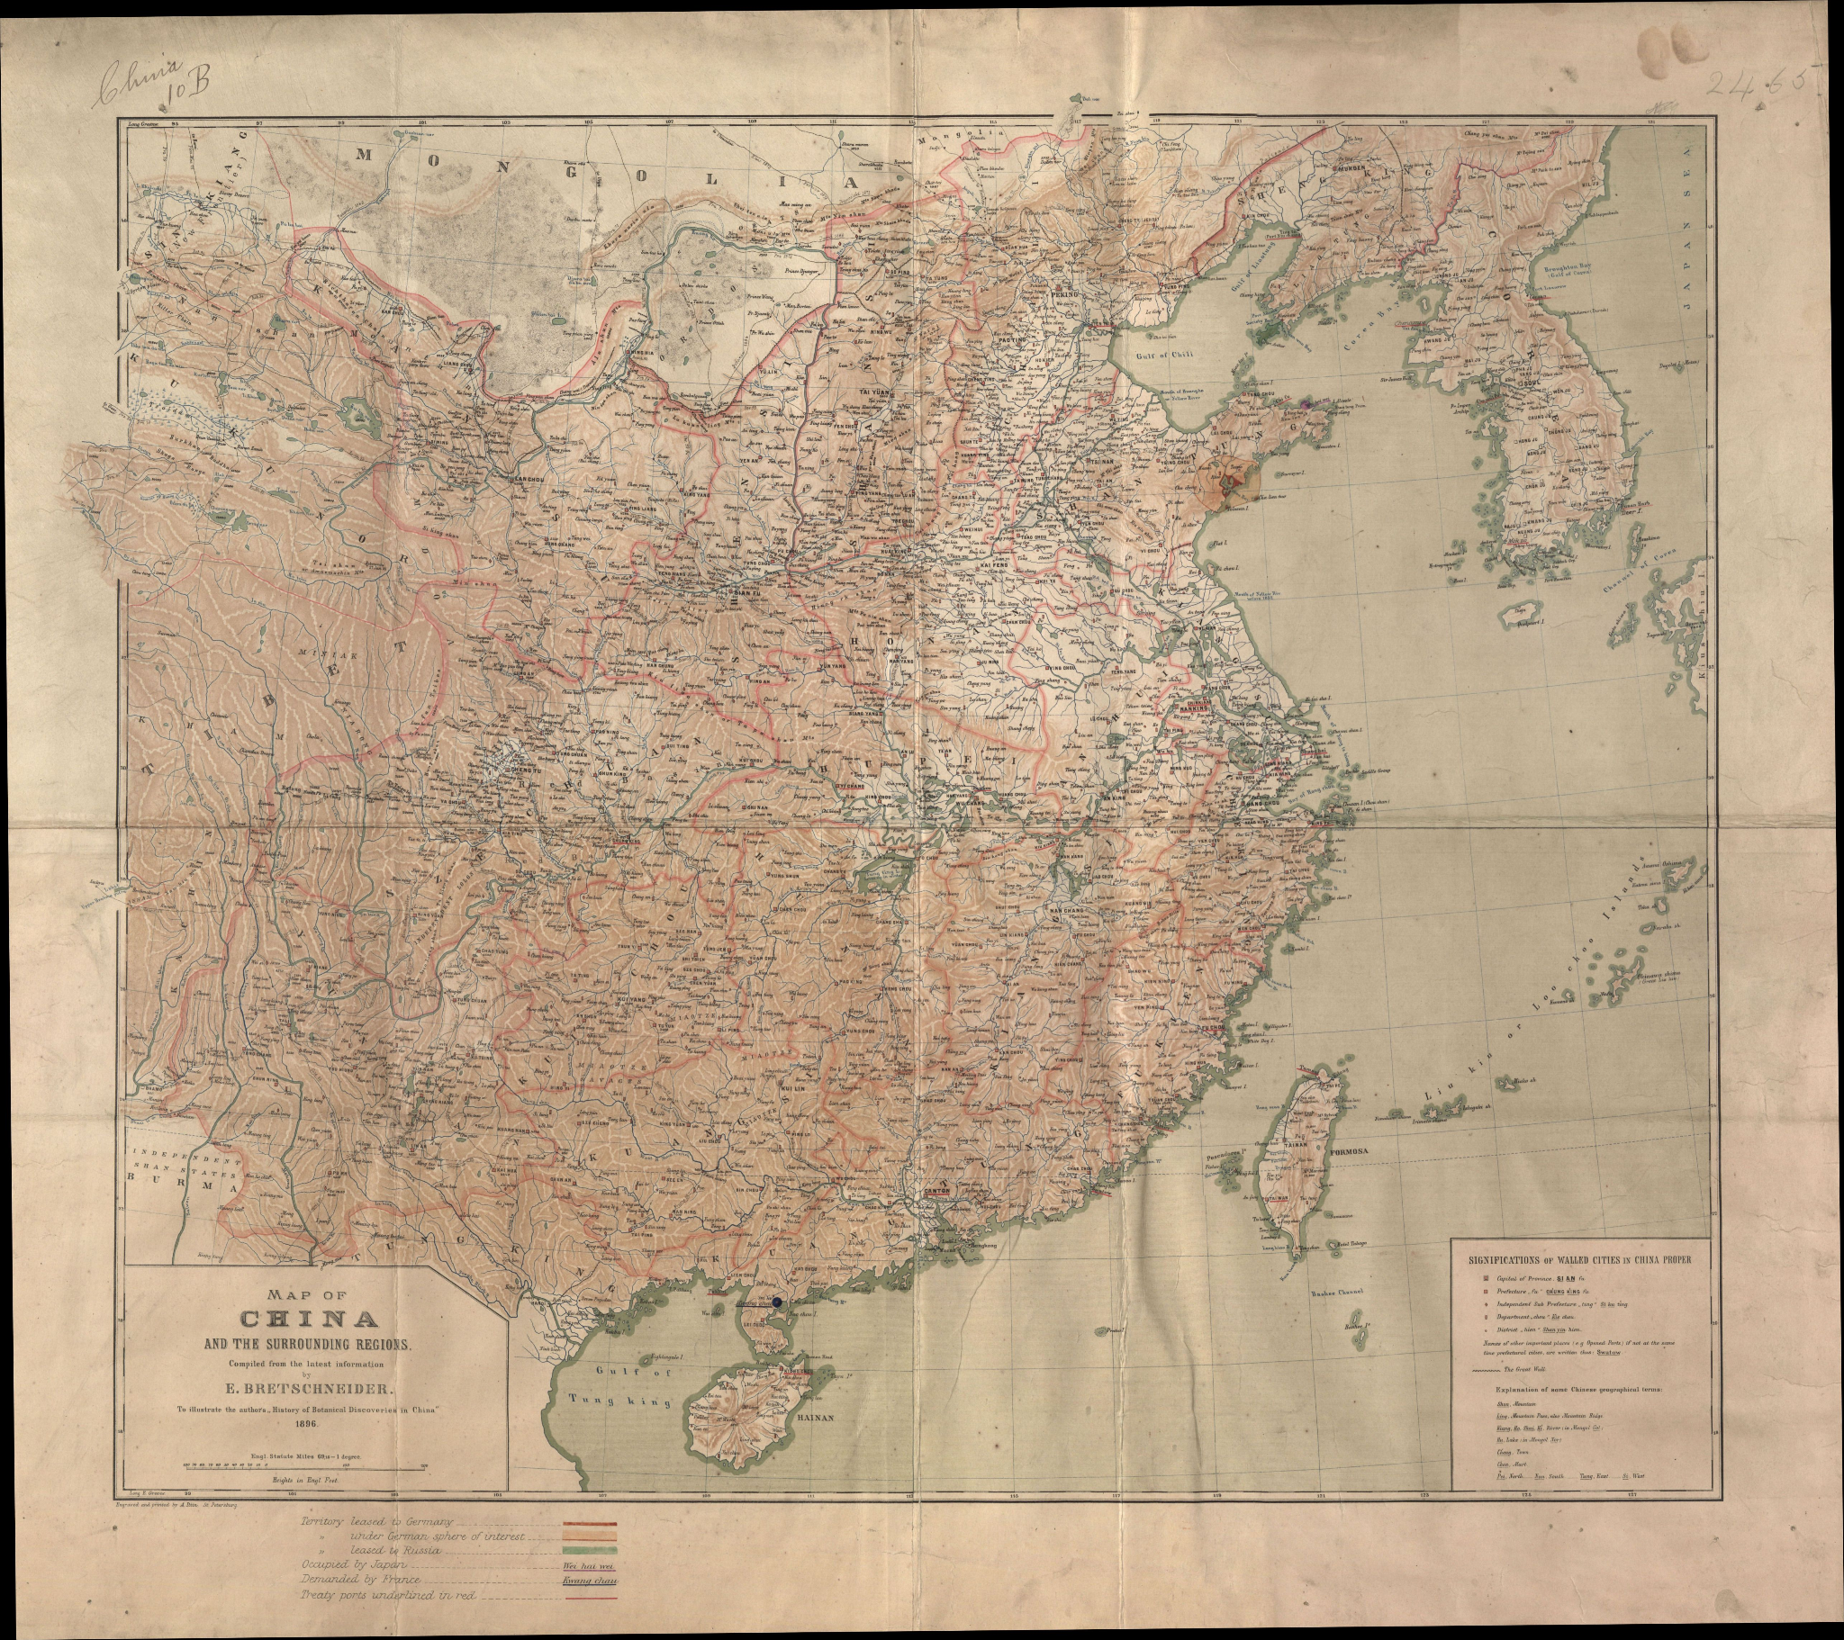

Slide 6
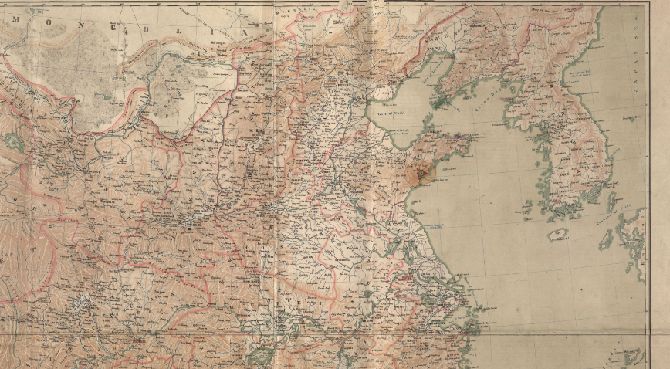

Slide 7
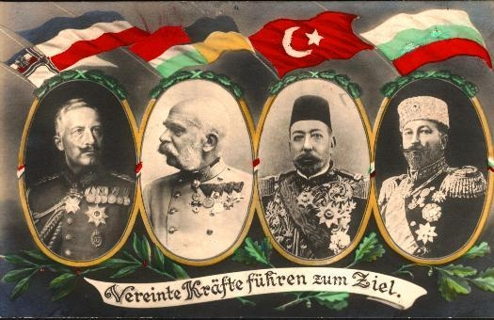
Leaders of the Allied

Slide 8
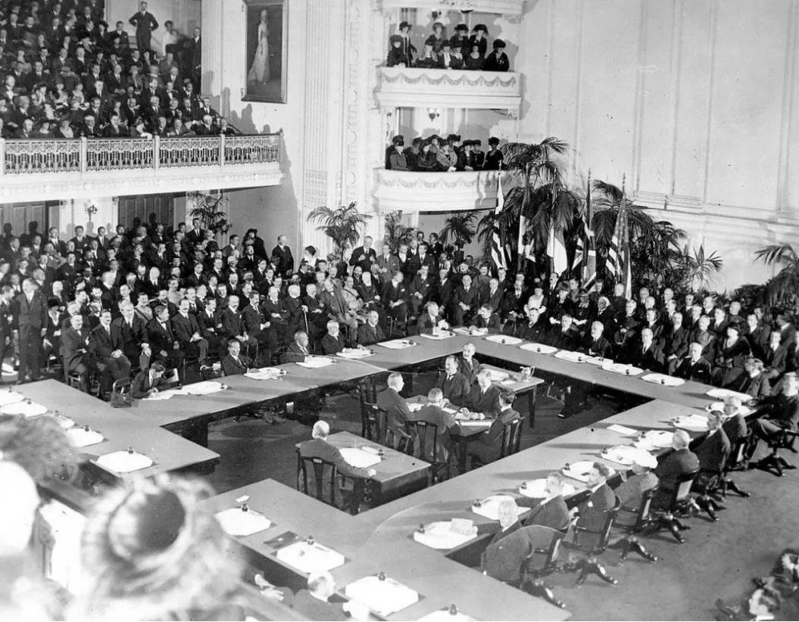
Paris Peace Conference, Jan 18, 1919

Slide 9
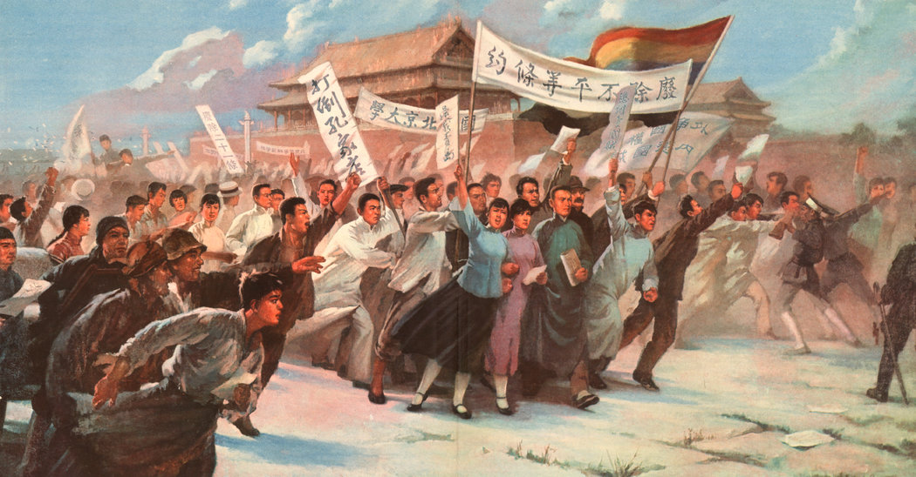

Slide 10
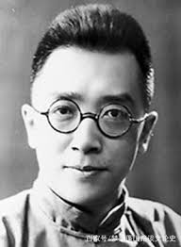
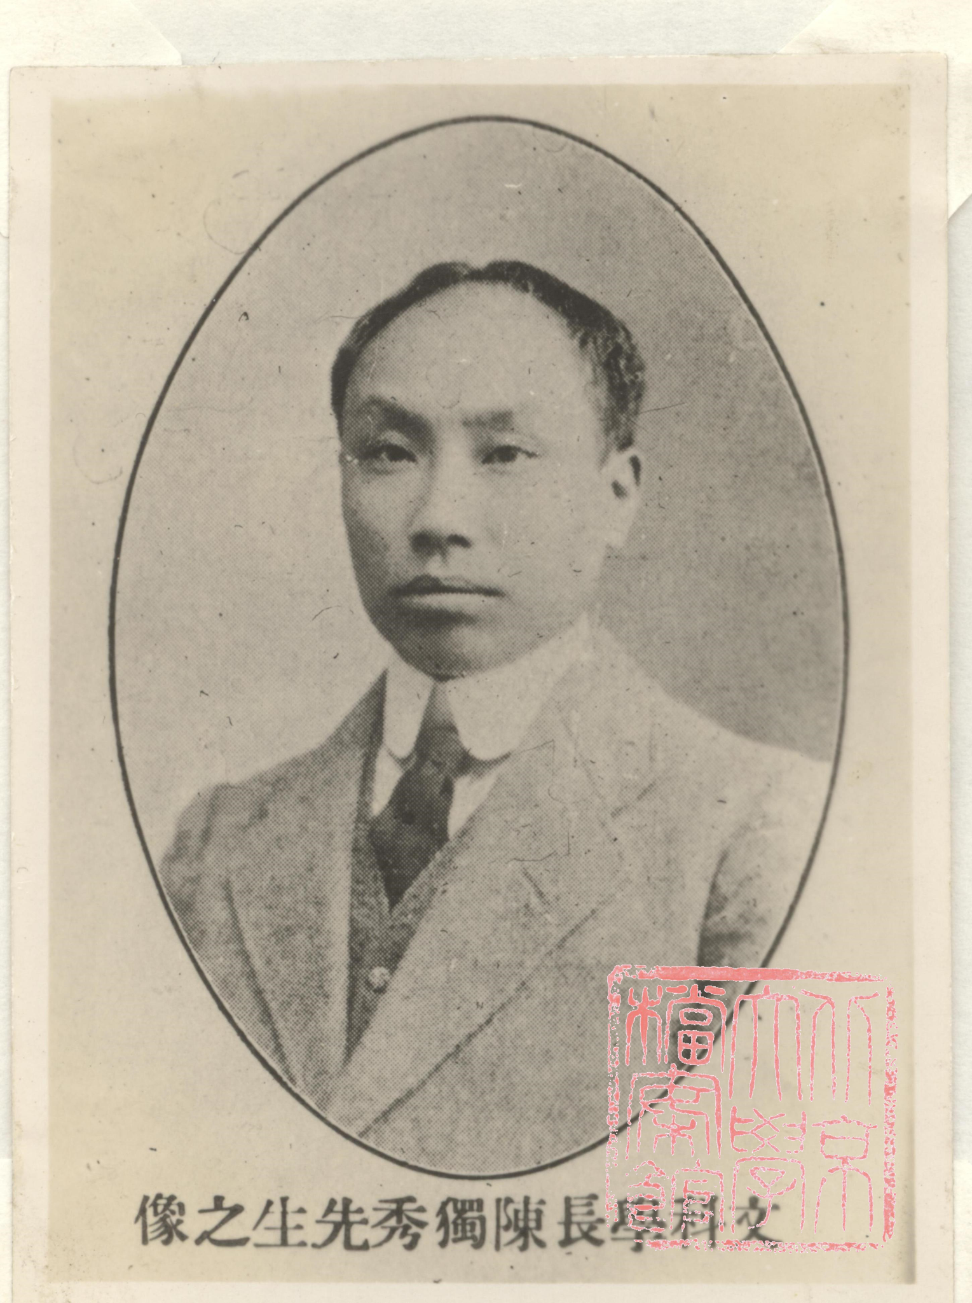
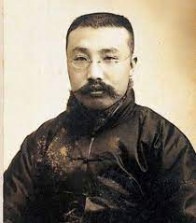
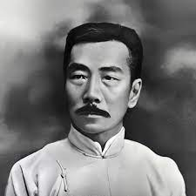

Slide 11
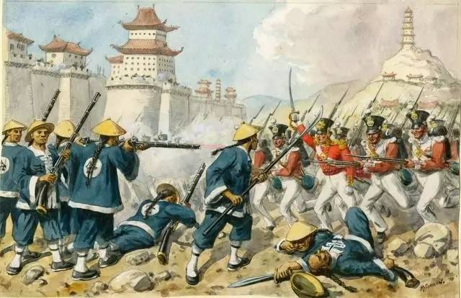
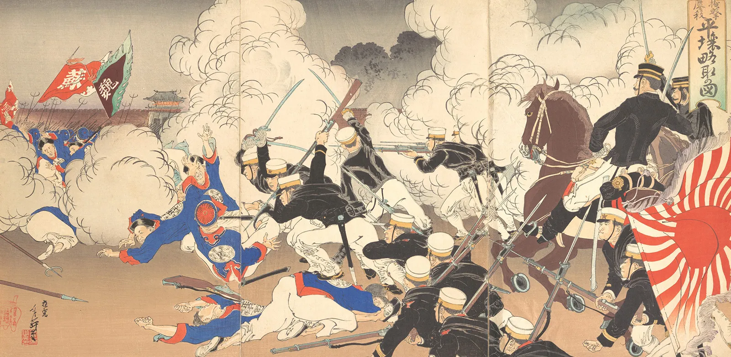
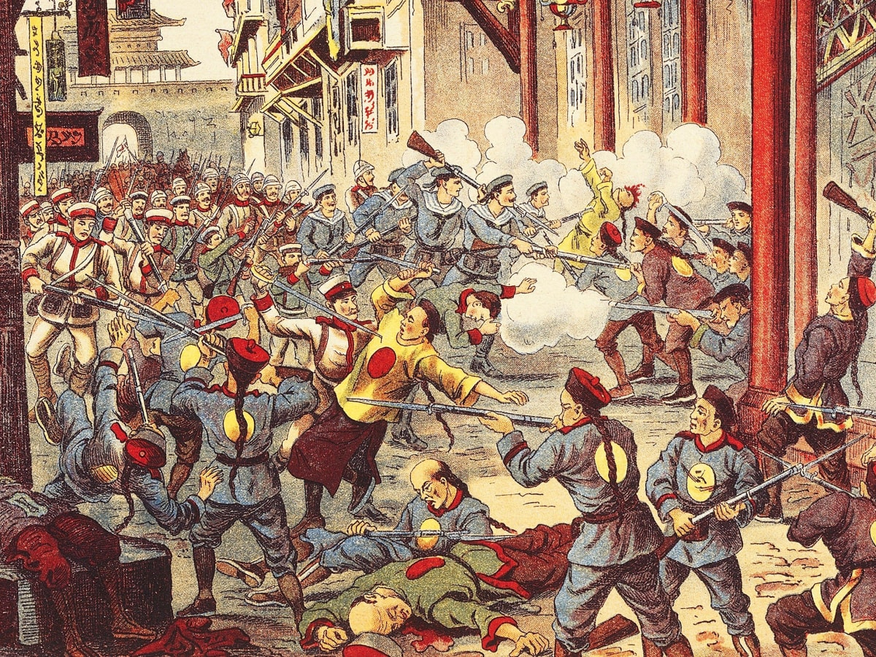

Slide 12
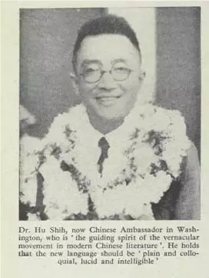
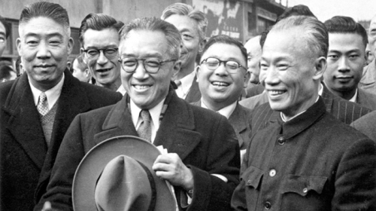
Classic Chinese (文言文） Vernacular (白话文）

Slide 13
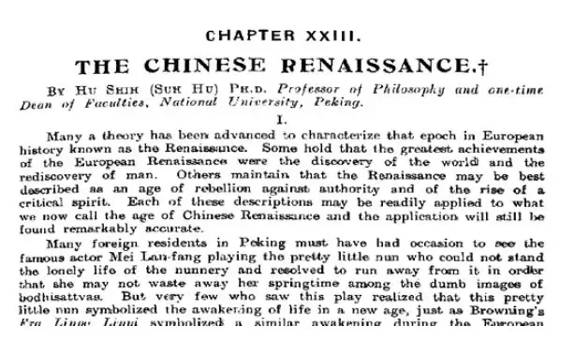
Hu Shi’s article in “China Year Book” 《中国年鉴》

Slide 14
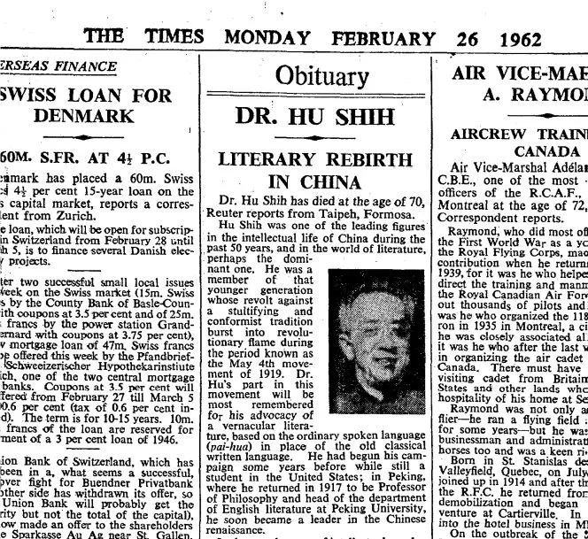

Slide 15
“It was the best of times, it was the worst of times, it was the age of wisdom, it was the age of foolishness”
Charles Dickens

Slide 16
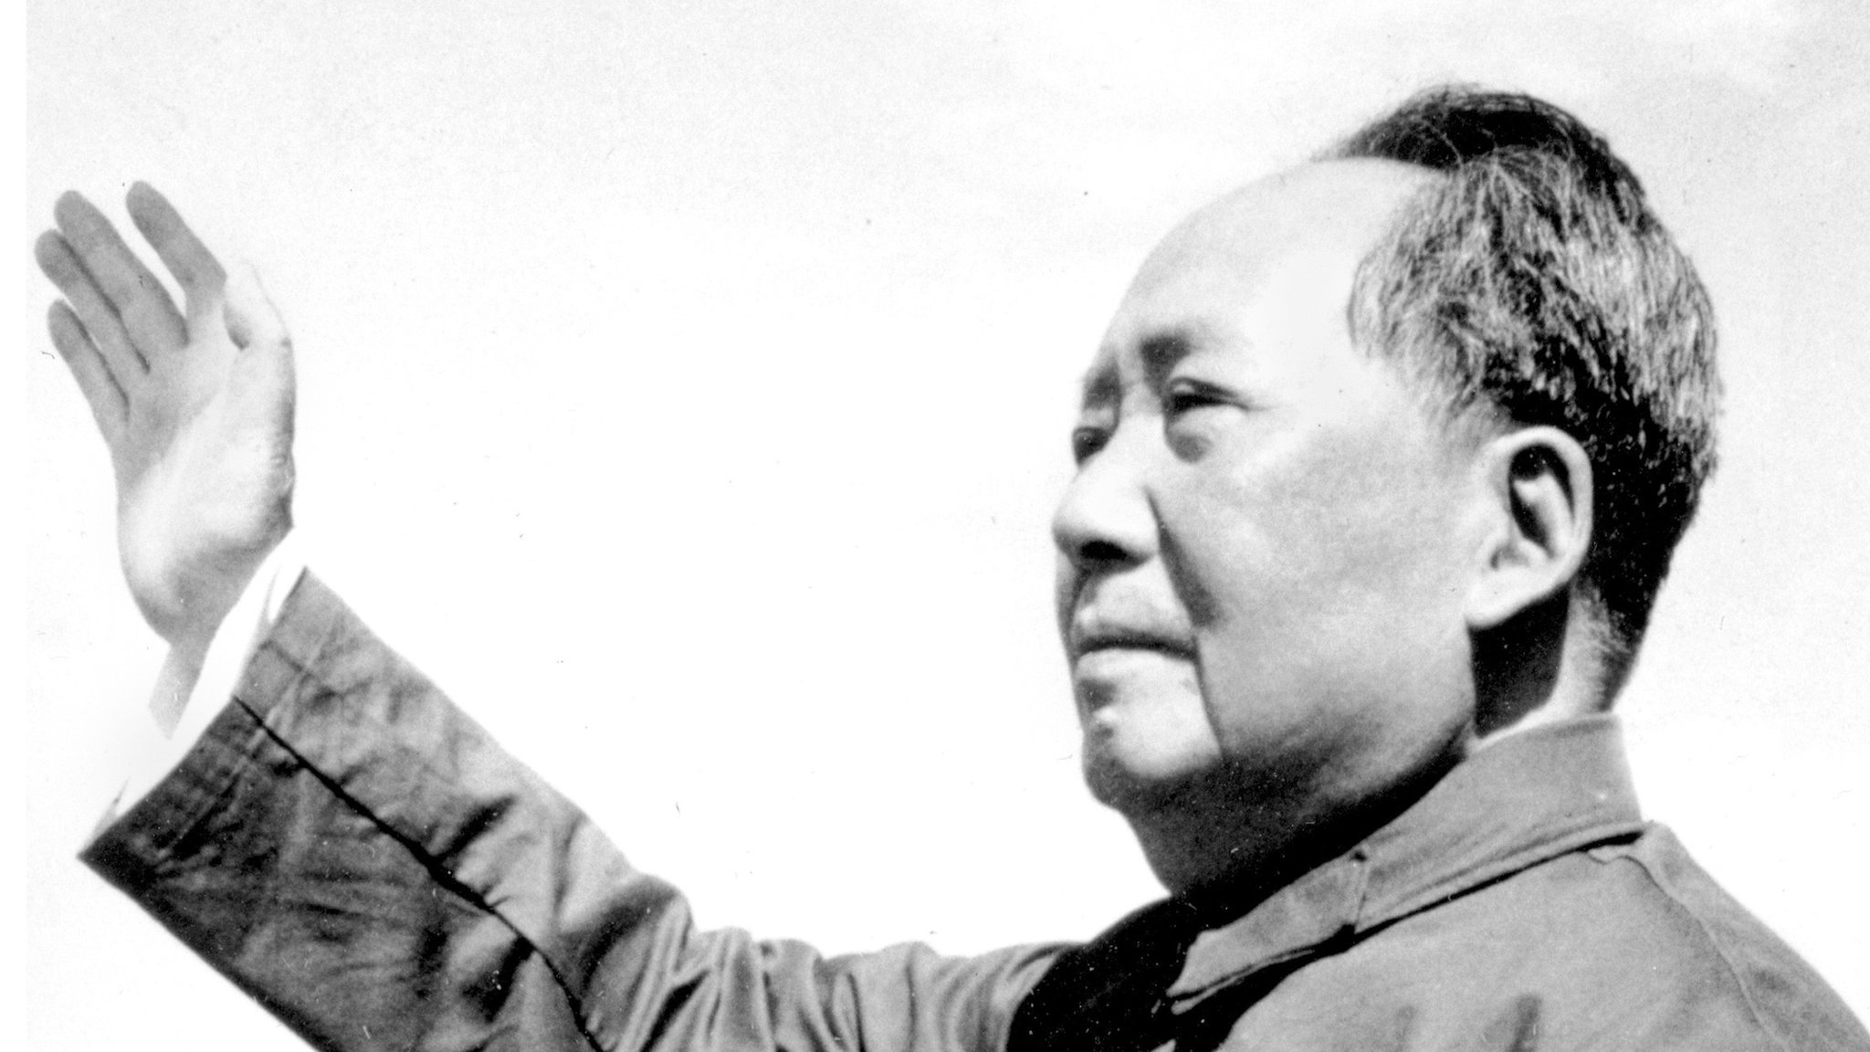
Thank you!

