Slide 1
The Oxymoron “Cultural Revolution” and its Relation to China’s Progression of Government
By Alexis Payne

Slide 2
Culture
Represented as:
“Methodical”
“Rational”
“Sophisticated”
Defined as:
Customs
Ideas
Rituals
The Link:
Social Order
Culture creates rules, norms, and morals and society implements social order by accepting and following said regulations, allowing for the society to function in a civilized manner.

Slide 3
Revolution
Influenced by Western society:
Violent
Must be bloodshed
Oftentimes includes war
Influenced by Government:
Most used in relation to politics
Overthrow of one governmental system for another
The oxymoron of “Cultural Revolution” basically equates to “Orderly Chaos”.

Slide 4
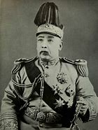
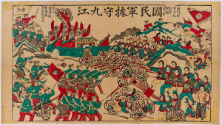
The Monarchy
Art depicting the struggles between the activists and the monarchical forces during Xinhai Revolution,
Yuan Shikai was a military general, and he rose to power in 1911 as Prime Minister of the Imperial Cabinet. He worked with the revolutionaries (Sun Yat-sen, at that time Pres of ROE), eventually abdicating the last Monarch of China in exchange for becoming President of the Republic of China.

Slide 5
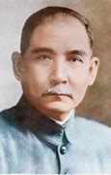
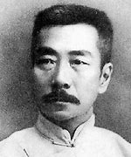
The Republic Influential Writer
Sun Yat-sen, the first Provisional President of the Republic of China. He lead several revolts against the Qing Dynasty, and helped deconstruct the monarchy, However, both times he tried to rule over the Republic (before and after Yuan Shikai) he was unable to gain enough support and military forces to become truly successful.
During this time period, Lu Xun was an influential figure with his writings of “The True Story of Ah-Q” and “Diary of a Madman” that represented a rejection of traditional customs such as Confucianism as well as the Monarchy. The story of Ah-Q specifically represents China’s reluctance to adapt to the ongoing global industrialism, thus leading to the downfall of the country.

Slide 6
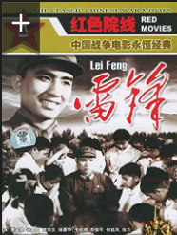
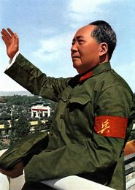
The People’s Republic Influential Film
Mao Zedong founded the People’s Republic of China in 1949. He was responsible for movement such as the the Great Leap Forward and the (capital C) Cultural Revolution.
The Film Lei Feng depicts a man who devotes his life to communism and maoism, He is shown to be selfless, earnest, willing to provide services to anyone in need. This film is known to be one of the many major communism propaganda campaigns within China.

