Slide 1
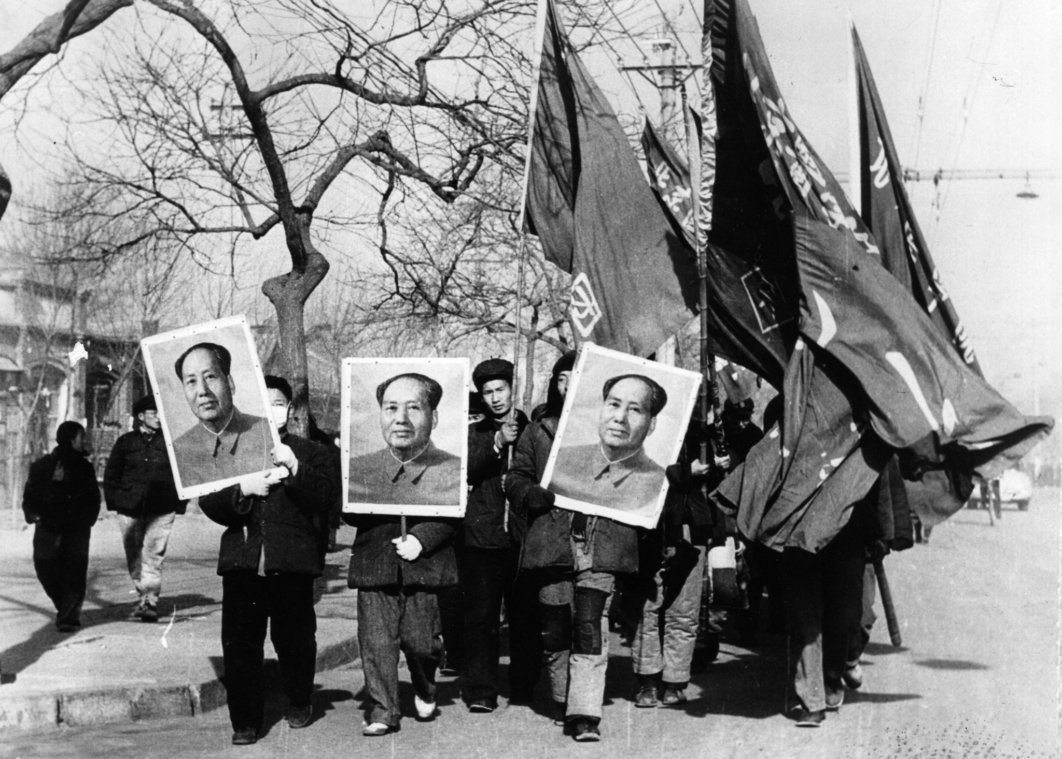
The Effects of Holism on Chinese People's Movements
By Finley Bodnar
By Finley Bodnar

Slide 2
What is Holism?
Holism is a philosophical theory which refers to societies which value the wellbeing of the group over the lives of individuals.
In this way, individuals in Holistic cultures are regarded as parts of a larger structured system.
“Part-Whole”
Holisms assign purposes to these wholes, and there is an established structure of individuals within the whole which creates a larger social hierarchy.

Slide 3
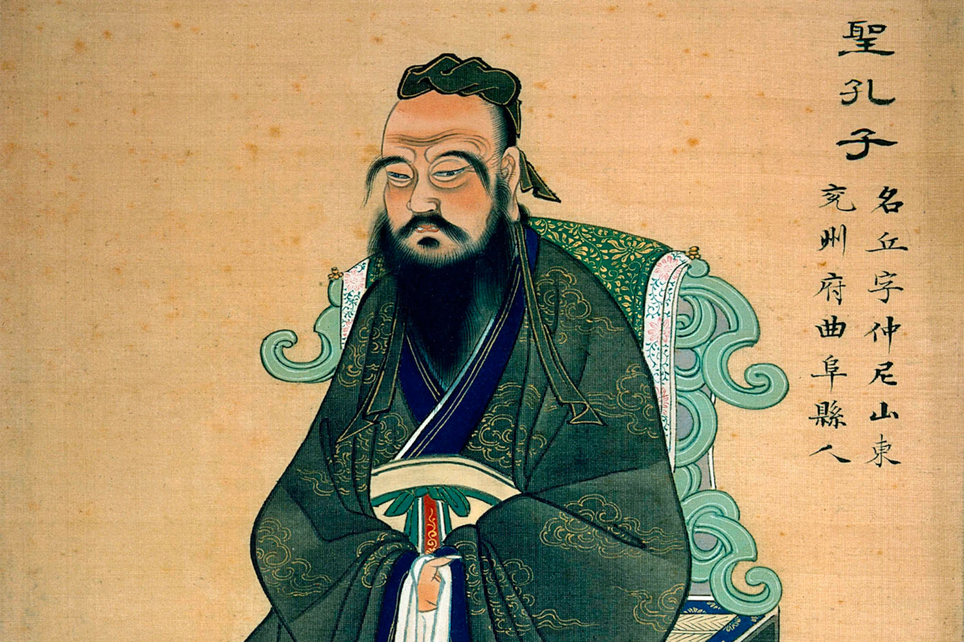
Confucianism
“Confucian’s focus on the organic relationship between the individual and society and consider the two inseparable and interdependent”- Ambrose King
In Confucianism, perfect virtue, and benevolence achieved by the individual is seen as the ideal.
Confucian states that to achieve this moral success, people cannot be isolated. Rather it is how individuals conduct themselves in their relationships with other people that moral righteousness is achieved.

Slide 4
Confucianism’s Values
The Five Social Dyads（五倫)
Affection （親）- between parents and children
Righteousness (义）- between ruler and subject
Distinction（别）- between husband and wife
Order （序）- between young and old
Sincerity （信）- between friends

Slide 5
How is Confucianism Holistic?
Non-familial social relationships are patterned after the familial structure.
(between ruler and subject) → (father - son)
(between friends) → (older brother - younger brother)
In Confucianism, Filial piety (孝) is considered central to the family and social existence.
While King alleges that each individual role in Confucianism was not initially hierarchical, filial piety was at some point made the most dominant ethical value.
“The basic theme of confucian ethics…did not seek a solution to social conflict in defining, limiting, and guaranteeing the rights and interests of the individual…It sought the solution from the self-sacrifice of the individual for the preservation of the group.” - C.K. Yang Chinese Sociologist

Slide 6
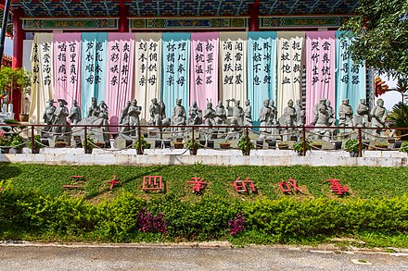
The 24 Filial Exemplars
The 24 filial exemplars were a set of short manuscripts which were meant to detail how men within the family should act.
Looking at these relationships in a contemporary light, some of them are very backward.
为母埋儿
卖身葬父
尝粪忧心

Slide 7
The effects of Holism during the age of Confucianism in literary and film depictions.
The new emphasis on filial piety applied a more rigid structure to Chinese life, and in turn made it become more holistically based. In this way, individuals were no longer able to make free social contracts independent of their socioeconomic background or societal standing. Rather I believe that Confucianism made life more focused on status, and the benefit of the larger whole. Ambrose King also states that laws in China underwent a process of “Confucianization” in which the familial hierarchy was also approved in law.

Slide 8
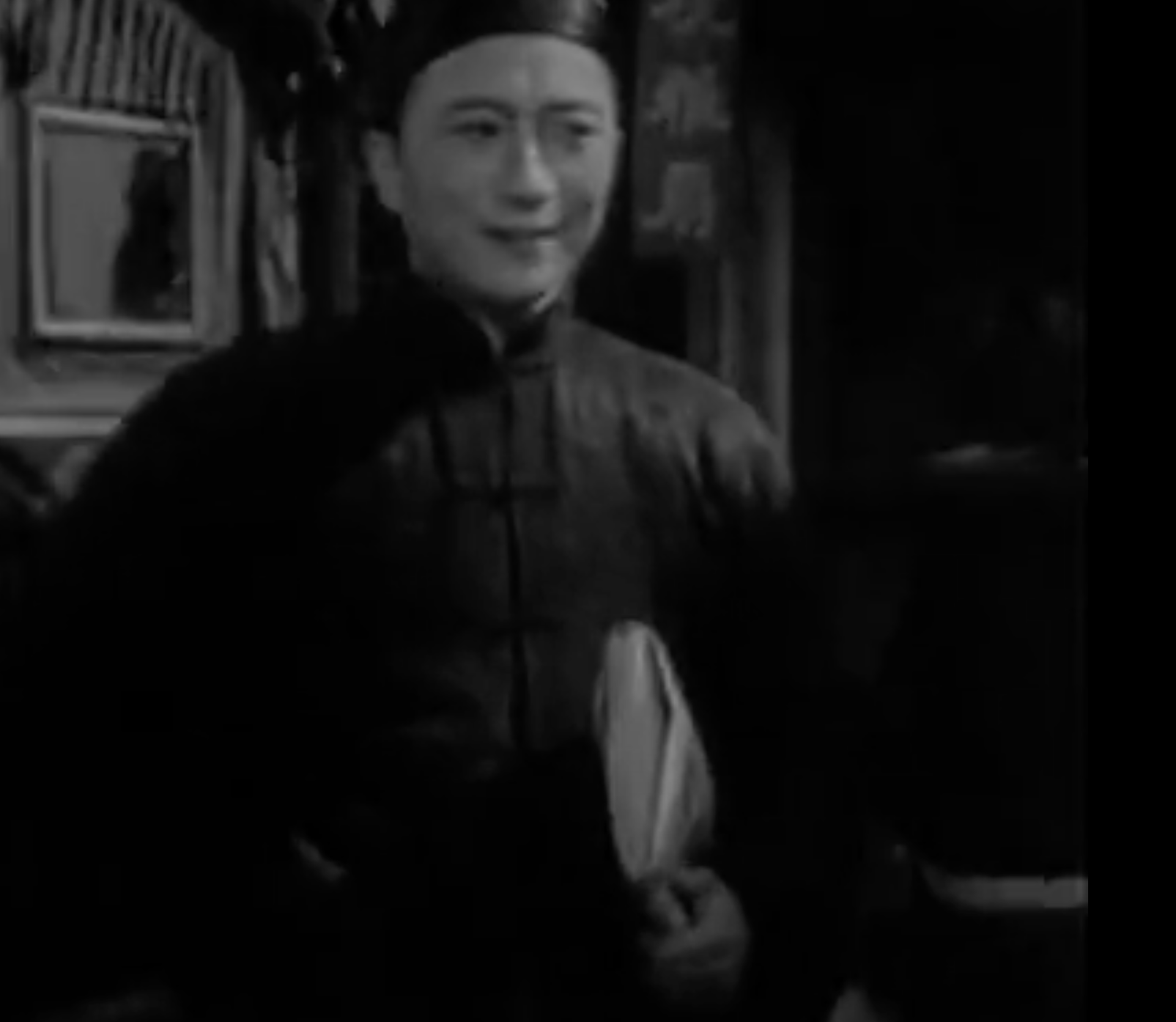
家 by 巴金，陈西禾，叶明执导电影
Jue-xin
Oldest of the Gao Brothers and the most filial.
Wants to marry MeiMei
Wants to pursue education
He is inhibited and destroyed however, when even though he continues to be filial and virtuous, he continues to be met with roadblocks and despair.
The death of his wife after being forced to follow filial piety is final straw.

Slide 9
黑白李 by 老舍
黑李
Oldest of the 李 brothers
Willing to sacrifice his love interest and house for his younger brother
黑李 says he should be supporting 白李 when he continues to exploit him for personal enjoyment
“Fourth Master doesn't give a damn about my legs, but he cares about my heart. Second Master cares about the little things, he takes pity on my legs-but he doesn't give a damn about this here."
In general, 黑李, the more filial and holistic of the two brothers is eventually executed for trying to hold his family together. He is a victim of a society which almost convinced him as though what was happening to him was just the natural way, and is taken advantage of.

Slide 10
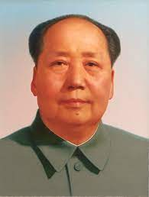
How is Maoism holistic?
I see Maoism as another Holism, in the way that it established a collective socioeconomic identity amongst Chinese individuals, separating out those who did not belong.
Mao created a new societal “whole” (part-whole) → (Proletariat-PRC)
It is those who are considered bourgeoisie, reactionaries, and rightists which are seen as conflicting with the whole and are therefore purged.

Slide 11
Comparing the Holisms of Confucianism and Maoism
When comparing the two holisms, Confucianism restricts the actions and relationships of individuals and how they fit interact with society. Maoism on the other hand seems to remove the individual from society as though it were some type of germ. While before, during Confucianism, rebelling against the state ideology would hurt your larger social image and make you virtueless, Mao was able to politicize holism. His policies of reeducation, mass imprisonment for those who did not comply with the state approved ideology show that Mao is far more holistic than Confucius. In my eyes, Maoism seeks an end to social conflict by removing the choice of the individual as a whole, whereas Confucius advocates for self-sacrifice. He is at the top of a new social hierarchy which used to be occupied by the monarch.

Slide 12
Bloodlines
Blood became a form to assess one’s revolutionary subjectivity through family background (chushen) or class labels (jieji chengfen).
These unfavorable classes were labeled ‘Four Black Categories’, which included landlords, rich farmers, counterrevolutionaries, and bad-influencers. After the Anti-rightist Campaign in 1957, ‘rightist’ was also added to the list, making ‘Five Black Categories.’
On top of this, 黑四类 extended out into following generations of people. I think that this also tries to get people to comply with the collective identity because it makes it so being labeled one of the bad classes is something that will tarnish your family.

Slide 13
邢老汉和他的狗 by 张贤亮
In the story, a solemn and lonely man, Xing, strikes up a friendship with a dog he finds one day.
It is declared that all the dogs in Old Xing’s commune would have to die as they were using up too much food.
Anyone who did not follow this order would then be labeled a class enemy.
By the end of the year, a man who once was able to work for the commune died of sadness.
Xing on the other hand, who does not value the wellbeing of the collective over the life of his companion, dies out of grief for his actions as he is unable to see his actions as truly helping the collective identity.

Slide 14
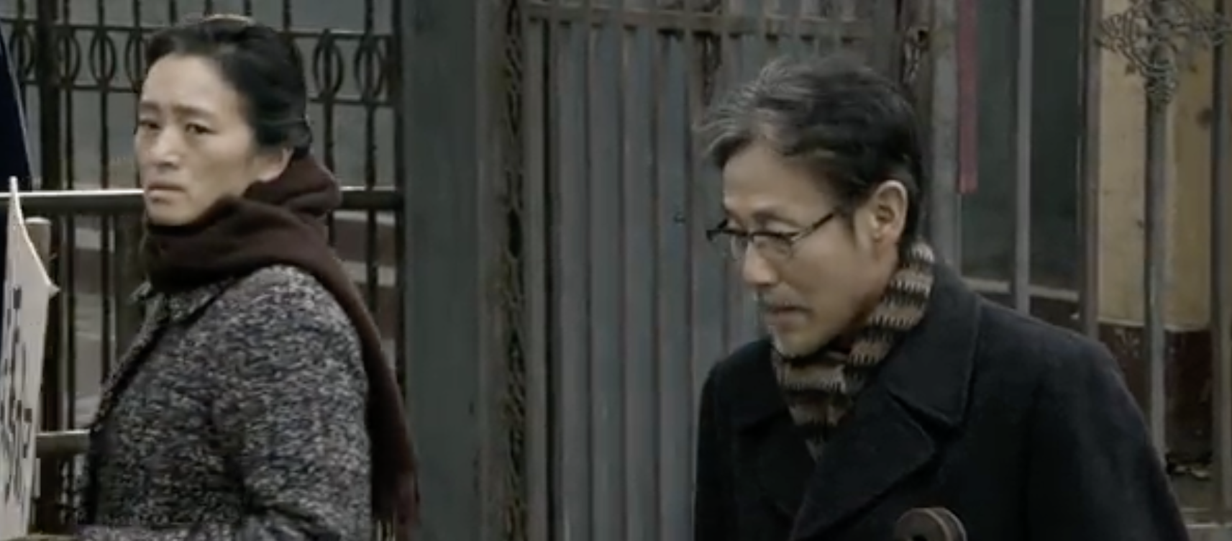
归来 by 张艺谋
With her father being a counter revolutionary, Lu’s daughter, Dandan, was unable to get the lead in The Brigade of Red Women.
When her father is sent away, Feng has been sexually assaulted.
Feng’s mind seems to have wasted away as a combined result of society’s and her own daughter’s disdain for her husband. As a result she forgets who he is, instead remembering Lu as her assaulter rather than husband.
Failure to comply with the collective identity has caused Lu to essentially lose the person that mattered to her the most.

Slide 15
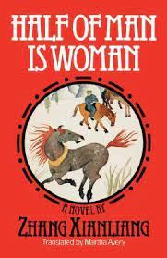
Half of Man is Women by Zhang Xianling
The story follows Zhang, a man imprisoned for rightist poetry which was counter revolutionary.
Finds out he is sexually impotent, and it is likely a mental issue as a result of a long time spent in incarceration.
Zhang believes that he himself is less of a man as he has grown more mindless, and desensitized
Failure to follow the collective identity was an impairing factor in Zhang’s life, altering him physically, and degrading his prior intellect.

Slide 16
Conclusion
After looking at the holisms of Confucianism and Maoism, while both seem to have similar limiting factors for individuals in China, how they go about controlling people's lives is very different.
In Confucian times, those who do not act with the sole purpose of serving the family are looked down upon, sometimes publicly, but they are not often jailed for their actions as though they have committed a crime. Instead they are taken advantage of and experience tyranny from those above them in the social ladder.
Maoism is therefore in my opinion, a far more aggressive and restrictive holism. By politicizing societal needs, Mao creates the ideal collective of Chinese people, the proletariat. It is since this proletariat class appears as the ideal people, that Mao is able to be the king of the poor, whose vision of the country is employed as though he were a monarch.
The 24 Acts of filial Piety is imbued with the spirit of Confucian humanism, whereas the countless acts of “class struggle” is imbued with the human spirit of Maoism as a form of holism.

