Slide 1
Back to traditional ways or does modernity change it?
By: Lindsay Walker

Slide 2
How do you define the word “modern” in the case of China? Is it meaningful or how meaningful to talk about China in such polarities as “modern” and “traditional”? Give examples in the arts in which changes are represented as “progress” for the better.

Slide 3
Definition of Modern
Website Definition:
Relating to the present or recent time as opposed to the remote past
Ex. The road leading to the castle was modern blacktop. Gabriel didn’t need to understand modern science. The castle was restored in modern times. The appliances were modern but the cabinets were old and solid.

Slide 4
A Modern Poet
Hu Shih an author who creates short but meaningful poems during the 20th century. He was one of the most influential post-imperial thinker and writer.
Considered an unmatched poet formulated new approaches to old problems
“Do not avoid popular expressions or popular forms of character” Hu’s belief that modern literature should be written in vernacular, rather than classical Chinese. He believed that this practice had historical precedents, and led to greater understanding of important texts.

Slide 5
My Son by Hu Shih
Yet a son has arrived on his own.
The banner of “No Descendants Doctrine”*,
Henceforth can never be proclaimed again!
Just as flowers blossoming on a tree,
So the flowers fall and fortuitously bear fruit.
That fruit is then you,
That tree is thus me.
The tree originally had no wish to beget offspring,
And I certainly have no favours to give you.
But since you have arrived,
I cannot not nourish you teach you,
That is my duty and responsibility to humanitarianism,
And not about granting to you grace and favours.
In the future when you have grown up,
Do not forget how I teach/admonish my son:
I want you to be an upright principled man,
Not to be my filial son.
真的不想要兒子，
然而，一個兒子獨自來到了這裡。
“無子道”*的旗幟，
從此不可再宣！
就像樹上盛開的花朵，
所以花落了，偶然結出了果實。
那果子就是你，
那棵樹就是我。
樹原本不想生育後代，
我當然沒有什麼可以給你的。
但既然你來了，
我不能不滋養你教你，
這是我對人道主義的義務和責任，
而不是給予你恩典和恩惠。
長大後的未來，
不要忘記我是如何教導/告誡我兒子的：
我希望你做一個正直有原則的人，
不做我的孝子。

Slide 6
Vernacular Language Movement
Vernacular represents an intellectual/political agenda who saw ‘classical’ and ‘local’ as impediments to literacy, education, and thus modernization. These intellectual advocated vernacular into writing and speech
Vernacular writing was “closer” to the living language of the people. It also allowed people to understand/write/read it as well as it being appropriate for a modern nation.
Eventually vernacular language unified with the national language especially in the May Fourth Movement which erupted in 1919
https://www.youtube.com/watch?v=9Fy6nCW6lXQ
11:50-13:03

Slide 7
The May Fourth Movement
The Movement was directed toward national independence, emancipation of the individual, and rebuilding society and culture
!915 young intellectuals called “New Youth” attacked traditional Confusian ideas and exalted Western ideas, particularly science and democracy. They criticized liberalism, pragmatism, nationalism, anarchism, and socialism.
Moreover, Chen and Hu Shih proposed the vernacular writing style, replacing the difficult 2,000-year-old classical style

Slide 8
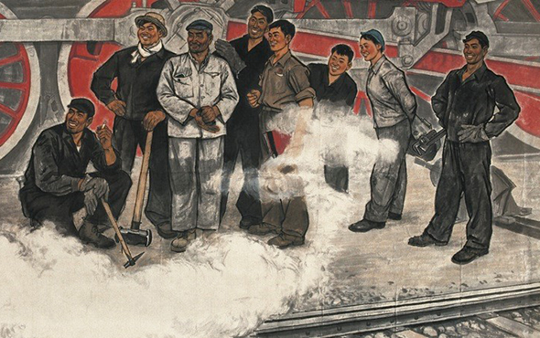
Lu Chen

Slide 9
“The Distant Relatives””
In the slide before showed men all staring at something, well Lu Chen’s theory might show these men looking into the future at the new modern China with Western ideas.
While traditional paintings were made Chen was able to add more “modern and westernization” blended in them. Therefore, the resources for the modernization of Chinese painting were eventually fixed on Western modern art in his arguments.

Slide 10
Lu Chen’s View on Westernization and Modernization
Started modern ink paintings in 1980’s, while he went abroad to France, came back and started to rebuild “ink composition.”
According to Lu Chen not everyone adopted the expression and composition of Western modern art, but he believed could feel the thing hidden in it. Moreover, the relationship between these works and traditional Chinese paintings has become intimate again.
Lastly, Lu Chen had every intention to transform Chinese paintings to Western art.

Slide 11
Is There Any Traditional Chinese Art Left?
Traditional Chinese Art was meant to capture and present philosophical life values, geopolitical landscape, and various perspectives.
Sculptures, Calligraphy, Paintings, Pottery and Minor Arts(gold/silver/copper/silk/wood/amber) were considered traditional art before Western or Modern arts were introduced.

Slide 12
Traditional Writing
One type of traditional artwork of China is calligraphy. Calligraphy was established during the Han dynasty(206 BCE -220 CE). This is a skill aimed to demonstrate control using an ink and brush.
Calligraphy influenced the importance of composition and the use of blank space.
Eventually, such notes and even poems became an integral part of the overall composition and an inseparable part of the painting itself. There was a fashion, too, for adding more inscriptions by subsequent owners and collectors, even adding extra portions of silk or paper to the original piece to accommodate them. From the 7th century CE owners frequently added their own seal in red ink, for example. Chinese paintings it seems were meant to be perpetually handled and embellished with fine calligraphy.

Slide 13
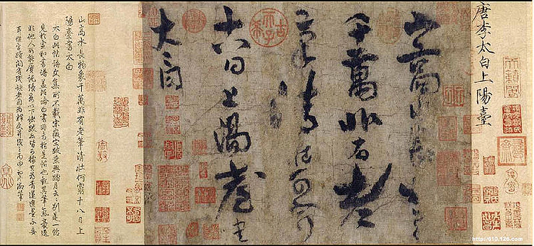
“Going Up to Sun Terrace” By Li Bai

Slide 14
Description of “Going Up to Sun Terrace”
From the slide before is written by a traditional poet named Li Bai.
English Dialect:
Mountains high, waters flowing, long and long—
the ten thousand solid things, a myriad of reflected images.
Even with a fine old brush—
and the hand to wield it—
how could all this clear and strong—
this spring and autumn turning—be exhausted?

Slide 15
Works Cited
https://dustysojourner.wordpress.com/2011/02/28/胡适：《我的儿子》-hu-shi-my-son/
https://brucespoems.blogspot.com/2013/12/dreams-and-poetry-hu-shih.html
https://languagelog.ldc.upenn.edu/nll/?p=30801
https://www.britannica.com/topic/Shirakaba
https://www.cafa.com.cn/en/opinions/interviews/details/8325471
https://www.worldhistory.org/image/4863/li-pos-calligraphy/
https://www.flashpointmag.com/libai10.htm
Human Literature

